Slide 1
Malaria detection Web App
CSE 3001: Software Engineering
Name | Reg No.
Gandharv Sachdeva | 19BCE0842
Aryaman Jaisinghani | 19BCE0853
Vikram Malani | 19BCE0856

Slide 2
Abstract
Early and effective testing and detection of malaria can save lives. We plan on building an accessible simple web app for easy detection of malaria in an image of a blood smear. Any person with minimal medical expertise would be able to simply upload an image of a blood smear and get an accurate prediction on whether they have been infected with malaria or not.

Slide 3
Objectives
Determine a machine learning approach to build a good prediction model.
Create an API that could easily be used to query the trained neural network.
Create an intuitive web app to get blood smear images from users and show them results of analysis in real time.

Slide 4
Introduction
Malaria is a mosquito-borne disease caused by a class of parasites. These parasites are transmitted by the bites of infected female Anopheles mosquitoes. Initially if an infected mosquito bites a person, parasites carried by the mosquito get in the person's blood and start destroying their oxygen-carrying RBCs (red blood cells). Thus, early and effective testing and detection of malaria can save lives. Since the introduction of AI in the medical field, scientists and doctors have started using AI for the analysis and identification of diseases.

Slide 5
Literature Review
TITLE | INTRODUCTION | OBJECTIVE AND METHODOLOGY | RESULTS AND CONCLUSION
[1] Transfer Learning with ResNet-50 for Malaria Cell-Image Classification Arrabelly, Sai Bharadwaj Reddy & Juliet, Sujitha. (2019). Transfer Learning with ResNet-50 for Malaria Cell-Image Classification. 0945-0949. 10.1109/ICCSP.2019.8697909. | Millions of blood films are examined each year for detection of malaria infection. Deep learning can be implemented in this field so as to minimize the chances of erroneous diagnosis due to various reasons. | The input involves a RGB image.The image will enter ResNet50 layer with the pretrained weights and the last layer is a classic fully connected dense layer with sigmoid activation.The input data will be trained with the pretrained weights So, auto-tuning is adapted for the BN layers in ResNey50. | The use of Transfer learning for malaria image classification begets good results. Using GPU’s or TPU’s along with the implementation of models like Google VGG can provide more accurate results in less down time.
Notes:
In the first paper titled TRANFER LEARNING WITH RESNET-50…, the author has implemented a transfer learning capable neural network for cell image classification. Millions of blood films are examined each year for detection of malaria infection. Deep learning can be implemented in this field so as to minimize the chances of erroneous diagnosis due to various reasons. We observed that using transfer learning along with. GPU’s or TPU’s and also the implementation of models like Google VGG can provide more accurate results in less down time.

Slide 6
Literature Review
TITLE | INTRODUCTION | OBJECTIVE AND METHODOLOGY | RESULTS AND CONCLUSION
[2] Improving Malaria Parasite Detection from Red Blood Cell using Deep Convolutional Neural Networks Aimon Rahman, Hasib Zunair, M Sohel Rahman, Jesia Quader Yuki, Sabyasachi Biswas, Md Ashraful Alam, Nabila Binte Alam, M.R.C. Mahdy | Malaria diagnosis is commonly carried out using microscopy but this method has its disadvantages as it is costly and depends on the dexterity of the pathologists. The proposed approach to aid the diagnosis process based on a 16 layer CNN would help to overcome this problem. | The proposed approach is based on a 16 layer CNN that would help overcome the dexterity required during the diagnosis process. The dataset used was issued from the NIH. | It is observed that data augmentation techniques on the training set provides promising results while using different preprocessing techniques doesn't have much effect. Among proposed models, TLVGG16 achieves an accuracy of 97.77% and outperforms all other models.
Notes:
The second paper we reviewed was titled Improving Improving Malaria Parasite Detection from Red Blood Cell using Deep Convolutional Neural Networks
In this paper the authors have tried to improve the existing convolutional networks instead of trying out new approaches like transfer learning. The proposed approach is based on a 16 layer CNN that would help overcome the dexterity required during the diagnosis process. It is observed that data augmentation techniques on the training set provides promising results while using different preprocessing techniques doesn't have much effect.

Slide 7
Literature Review
TITLE | INTRODUCTION | OBJECTIVE AND METHODOLOGY | RESULTS AND CONCLUSION
[3] Pre-trained convolutional neural networks as feature extractors toward improved malaria parasite detection in thin blood smear images Rajaraman, Sivaramakrishnan & Antani, Sameer (2018). PeerJ. 6. 10.7717/peerj.4568. | A majority of digital diagnostic softwares use ML techniques with hand engineered features but this process requires expertise in analyzing various properties of the image. This can be tackled by using deep learning models which implements a cascade of layers to discover the features of raw data. | The proposed CNN has three convolutional layers and two fully connected layers. The first step is the cell detection where we applied a multi-scale Laplacian of Gaussian (LoG) filter to detect centroids of individual RBCs. The generated markers are used to segment the cells within a level set active contour framework to confine the evolving contour to the cell boundary. | Manual point-wise annotation of infected and uninfected cells was used to evaluate cell detection. For each segmented cell, the number of manual ground-truth points in the segmented cell region were checked. If there was exactly one point in the region, it was counted as a true positive (TP). These counts then allowed us to compute the following for cell detection, PPV of 0.944, sensitivity of 0.962 and F1-score of 0.952.
Notes:
Another paper we reviewed goes into depth about pre trained convolutional networks. In this paper a novel approach of using deep learning models which implement a cascade of layers to discover the features of raw data is proposed. Here, Manual point-wise annotation of infected and uninfected cells was used to evaluate cell detection, leading to some very positive results.

Slide 8
Proposed Methodology
&
Project Modelling

Slide 9
Waterfall Model
For this project we are going to use the “Waterfall” SDLC model. As we can imagine proper planning is a must in waterfall model. Planning is the process of establishing the scope and defining the objective and steps to attain them, the scope of our project is a well-defined and we clearly identified the steps to achieve our goal. Waterfall model is simple and easy to use, moreover works well with small-scale projects where requirements are very well understood, in waterfall model very less customer interaction is involved during the development of the product (i.e., like ours).

Slide 10
Shortcomings of waterfall model
The biggest shortcoming of using the waterfall model is the inflexible partitioning of the project into distinct stages. In our case this is a blessing in disguise simply because the components of our project are vastly different by nature. The three major components of our project are:
Machine Learning model that predicts based on user input
An API (and backend) that connects the web app to the model
The web app itself, which is the single point of user interaction and the only thing that could be driven by the customer feedback.
Thus, all these components will have to be developed in seclusion and then connected together, which would work very well with the waterfall model.

Slide 11
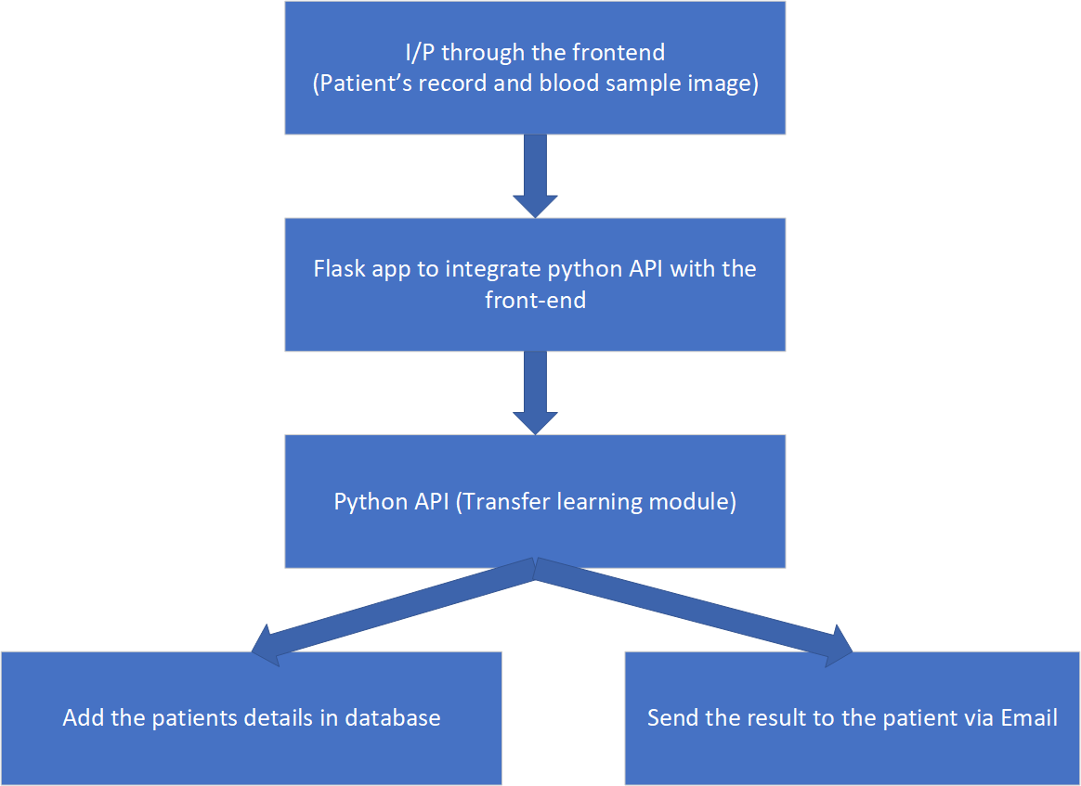
Functional Block Diagram

Slide 12
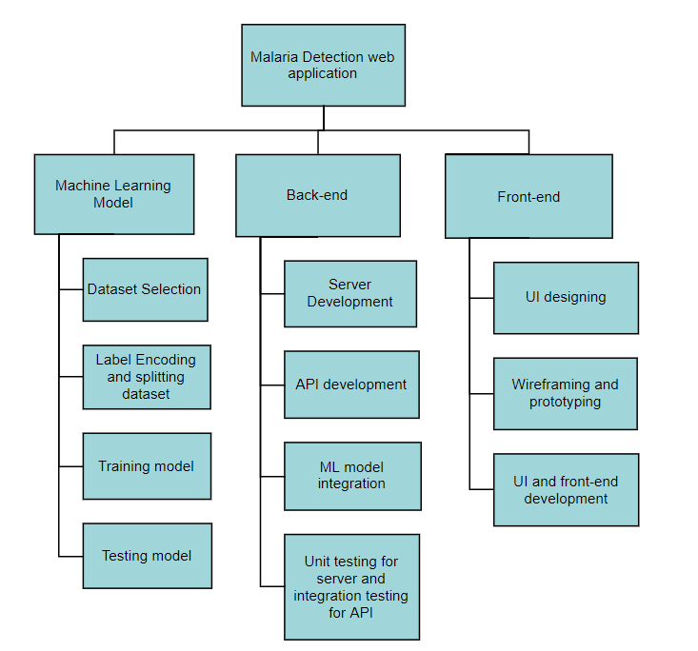
Work Breakdown Structure

Slide 13
Risk Analysis

Slide 14
Description | Type | Backup
Due to lack of a good dataset, or due to an ill-trained neural network, the prediction could be inaccurate and unreliable. | Project and product risk. Probability: Moderate | If we are unable to train a satisfactory model we will use already existing CNN models for Malaria detection.
The process of getting a blood smear is not very accessible, thus making the whole testing process somewhat tedious for medically untrained people. | Product risk. Probability: Low | There are no work-arounds for cell imaging, to reduce this risk we will transform and process all images before predicting.
Lack of accessibility on the web app could make the already difficult blood smear collection process even more cumbersome. So special focus has to be put on making the UI of the web app as intuitive and accessible as possible. | Project risk. Probability: Low | If we are unable to implement an intuitive UI, we will switch to COTS libraries for creating highly standardised and intuitive UI.

Slide 15
Requirements

Slide 16
Functional Requirements
ML model should give the results immediately.
Immediate communication of blood tests to the concerned patients.
User’s password should be in encrypted form.
Should display invalid email/password combination for unauthorized access.
Should not allow multiple accounts with the same email id.
Highly accessible web app design to help the users.

Slide 17
Non-functional Requirements
Performance Requirements
Since, our web app is focussed on providing essential medical information to users at the earliest, we have the following inexcusable performance requirements:
Average page load (from a user perspective) must be less than 500 milliseconds.
Slowest page load cannot take more than 4 seconds.
The app must be available almost 24 * 7.

Slide 18
Security Requirements
Secure access of confidential data (user’s details). We will use a NOSQL database with data sanitization to ensure the integrity and confidentiality of data is guaranteed.
Safety Requirements
Since we are training our own model it is of utmost importance to make sure that the users are made aware of this fact and they should also be made aware of the accuracy and confidence score that our model possesses.
Software Quality Attributes
As we are training our own Transfer Learning model we have to ensure that it squares up with the existing non transfer learning models being used for Malaria Detection. Also, as we are dealing with important medical data, we must test our web app for secure transmissions.

Slide 19
Implementation

Slide 20
Architecture
1. Web and Application layer: The first layer would consist of the application interface. It will communicate with other layers by feeding input from users and carrying out user operations.
2. Data layer: This is the most critical aspect of the application, it is where the userdata, operational data and metadata are stored for easy access and retrieval.
3. Database: A database implies a persistent and integrated storage allowing concurrent access to it by many users. It is a collection of records related by referential integrity. Thus, a database is an organized collection of structured data, to serve many applications with minimum redundancy.

Slide 21
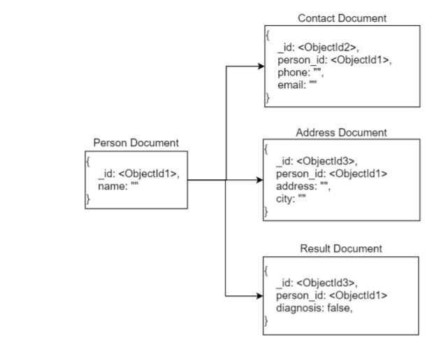
DATABASE SCHEMA

Slide 22
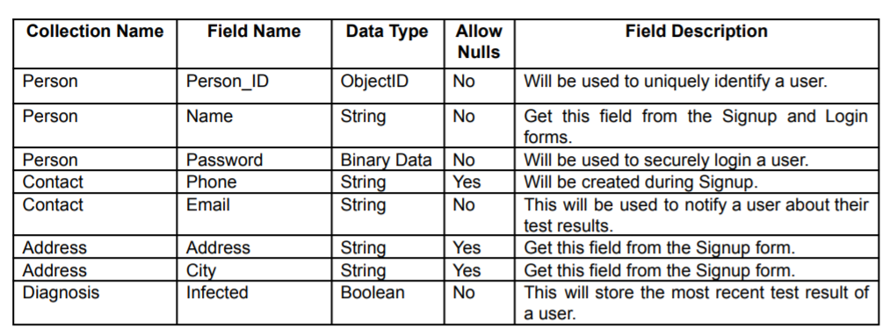
DATABASE FIELDS

Slide 23
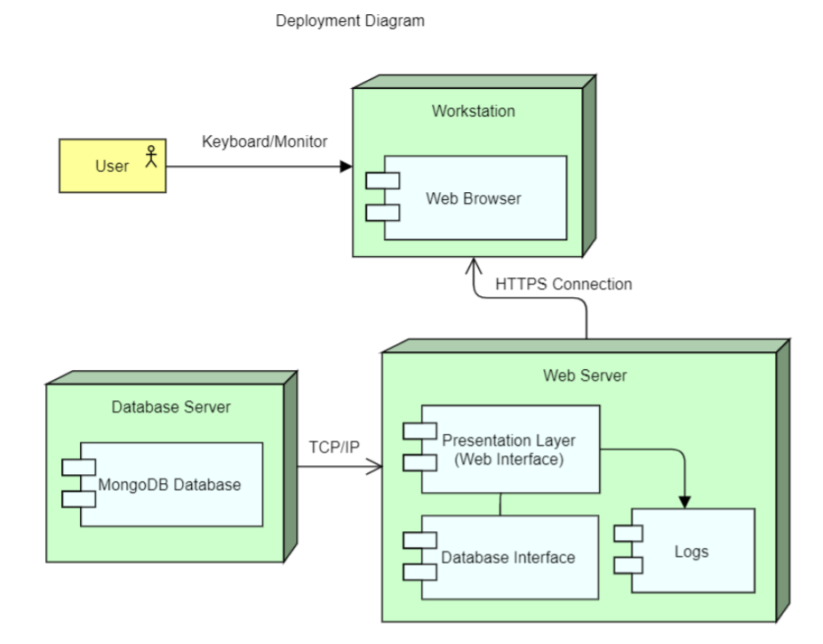
DEPLOYMENT DIAGRAM

Slide 24
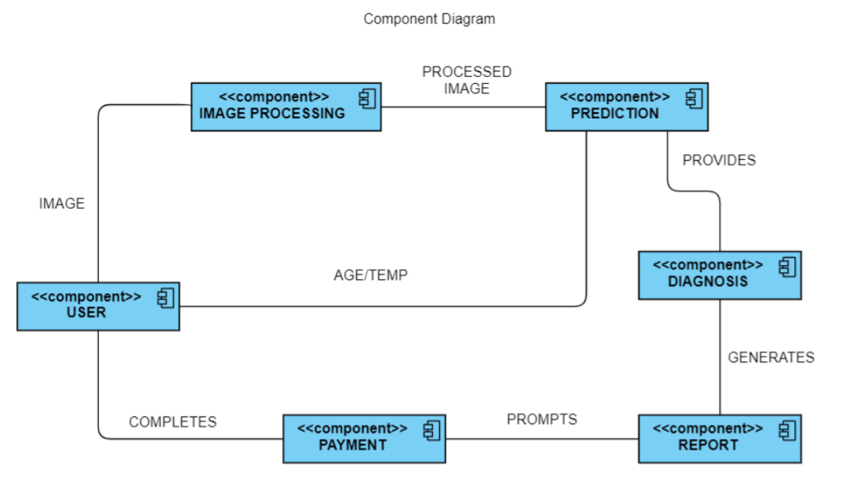
COMPONENT DIAGRAM

Slide 25
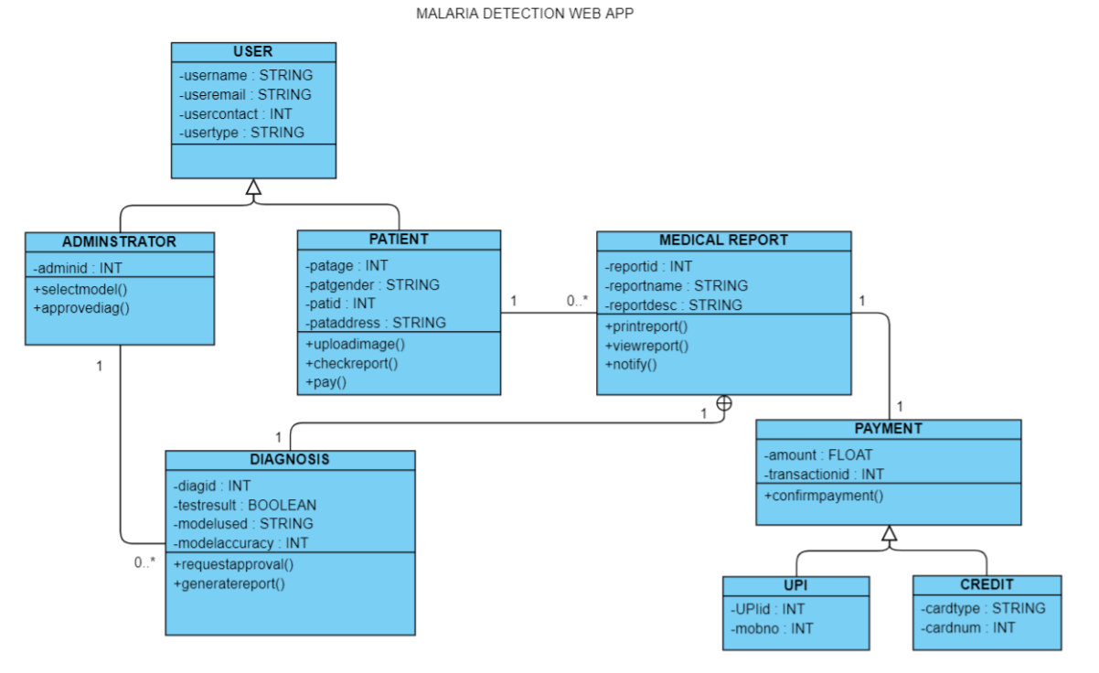
CLASS DIAGRAM

Slide 26
UI

Slide 27
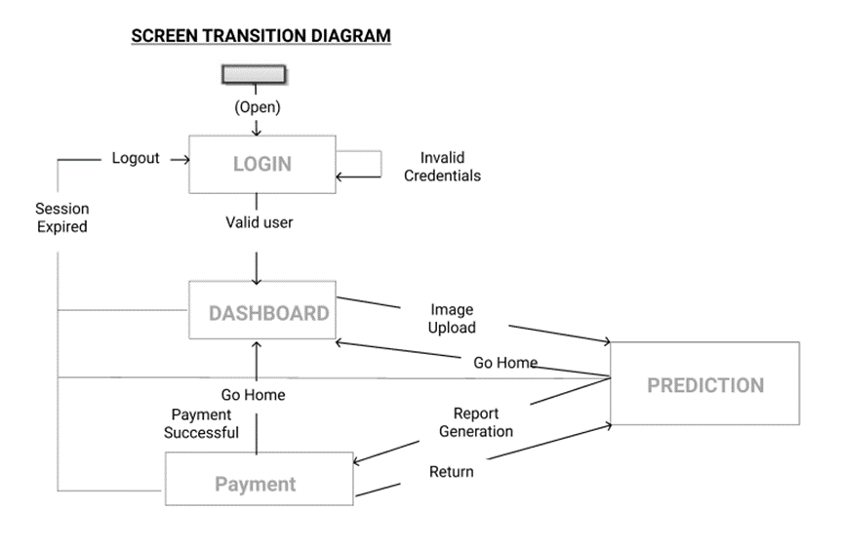
SCREEN TRANSITION DIAGRAM

Slide 28
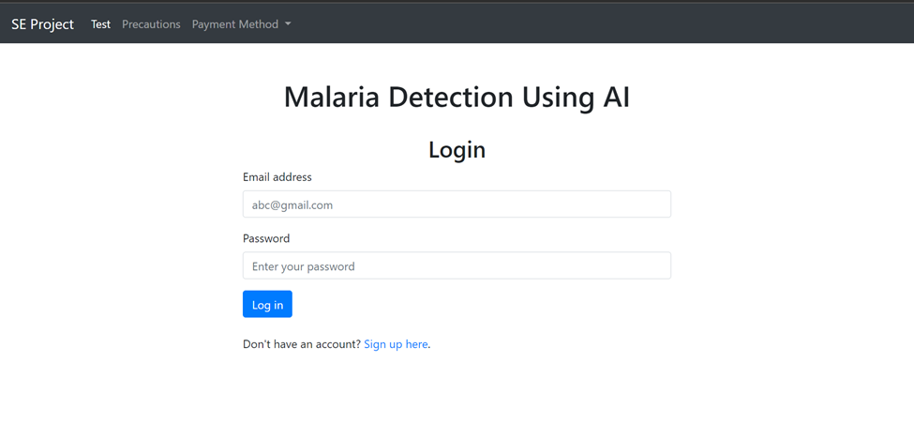
PROTOTYPES

Slide 29
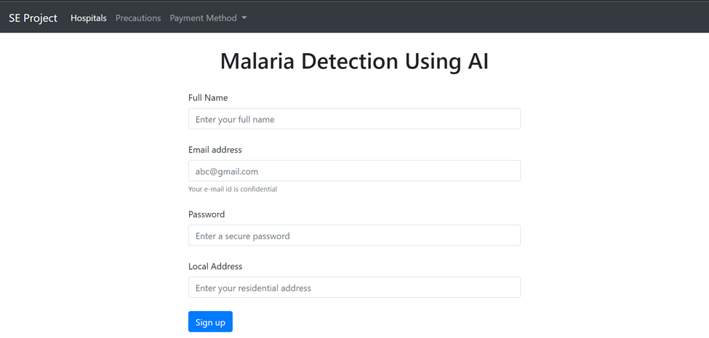
PROTOTYPES

Slide 30
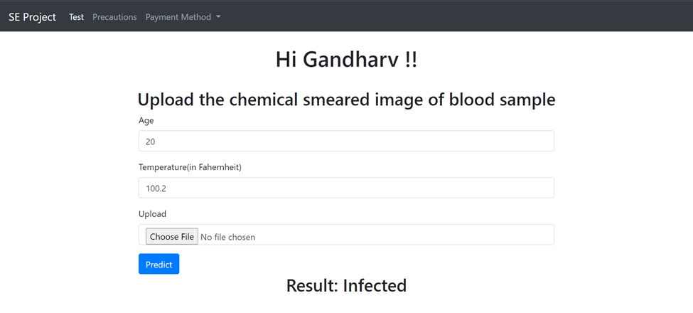
PROTOTYPES

Slide 31
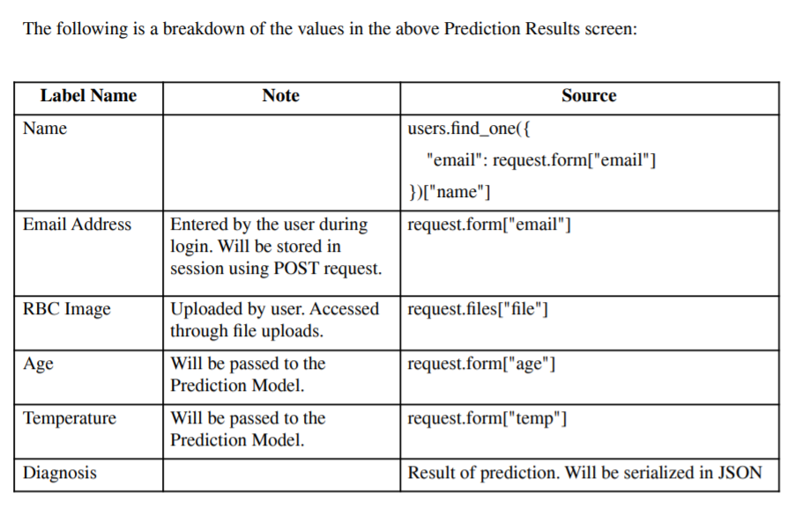
PREDICTION SCREEN

Slide 32
Screenshots

Slide 33
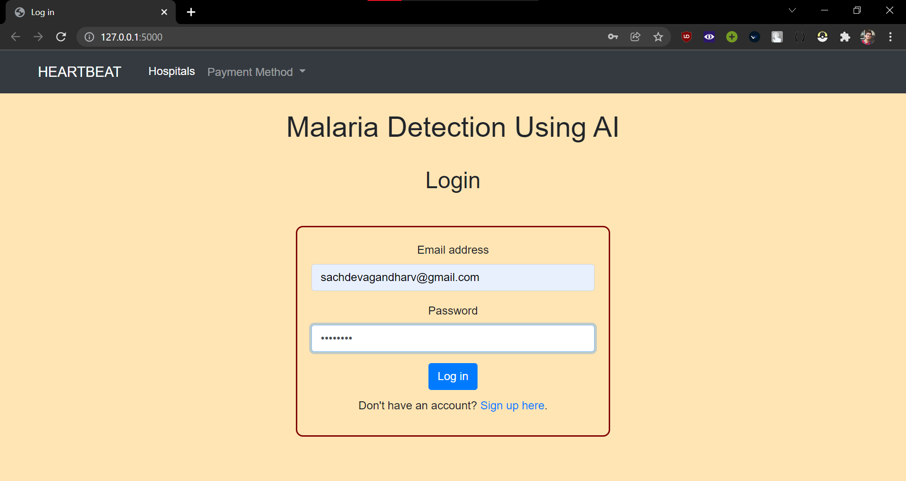
LOGIN SCREEN

Slide 34
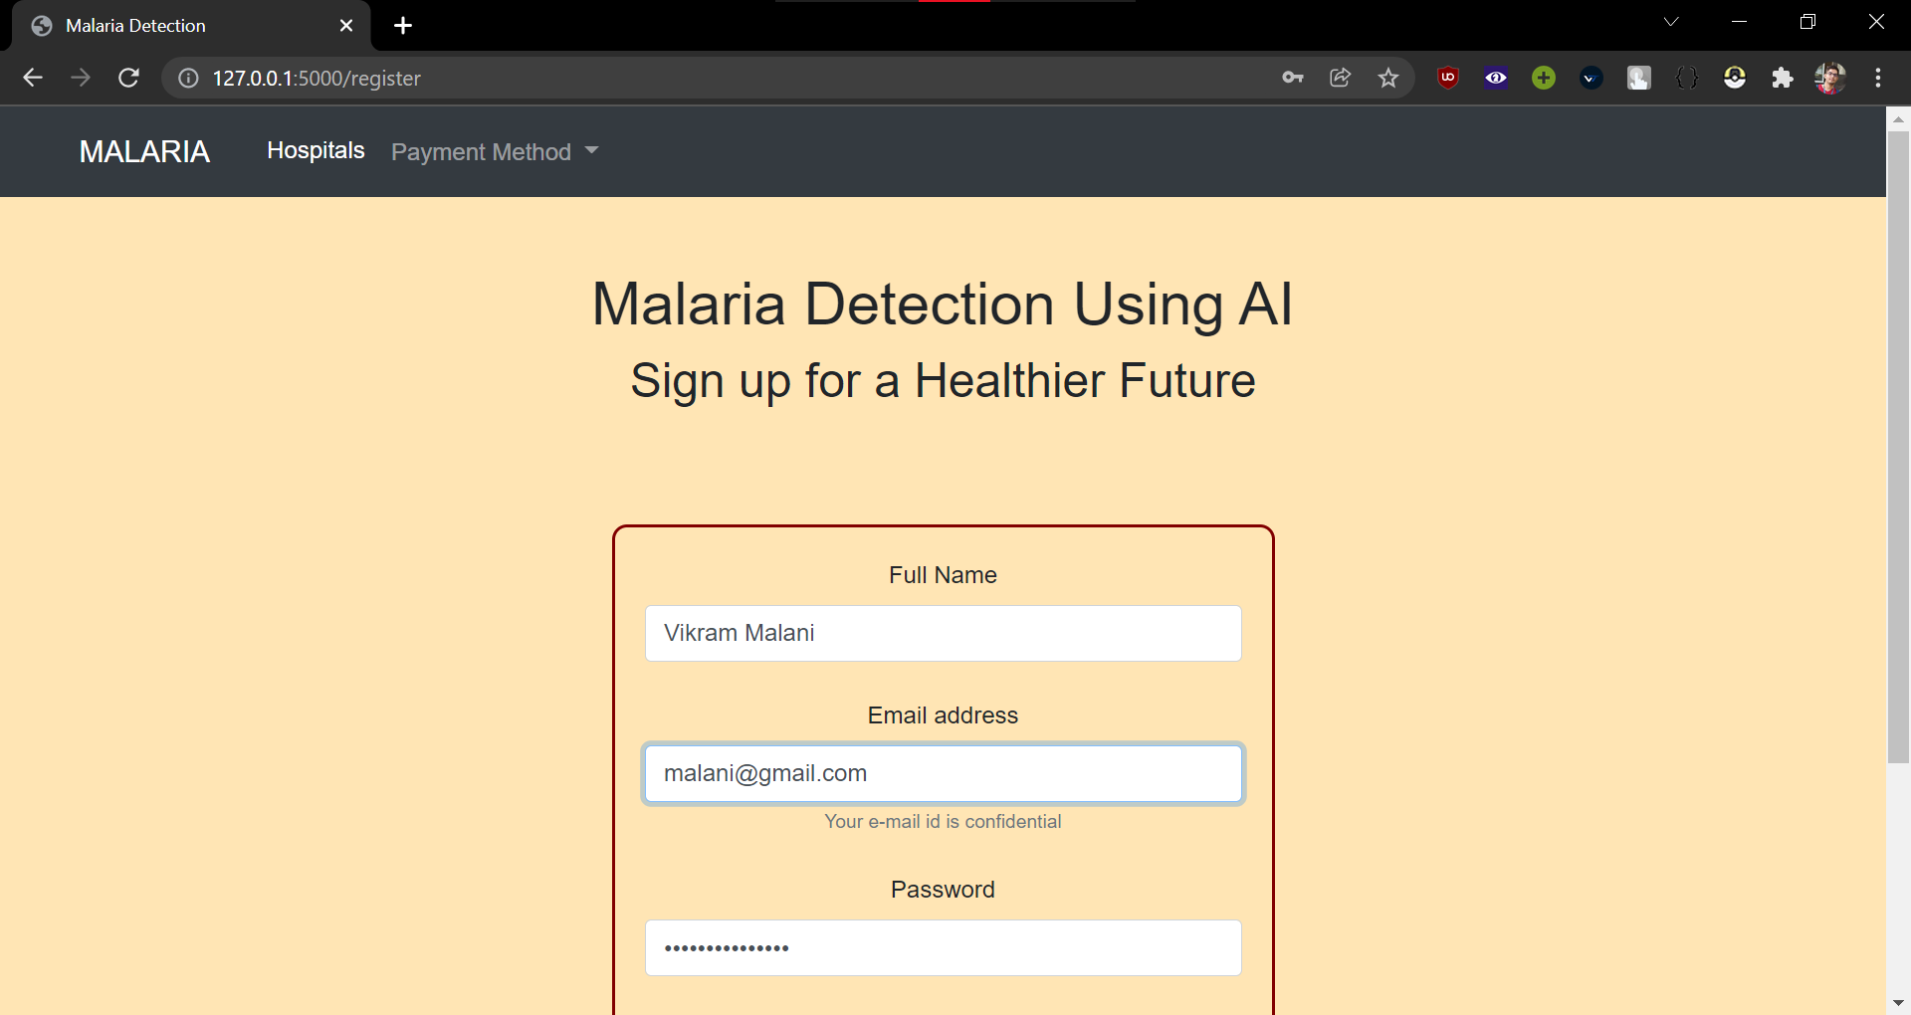
SIGNUP

Slide 35
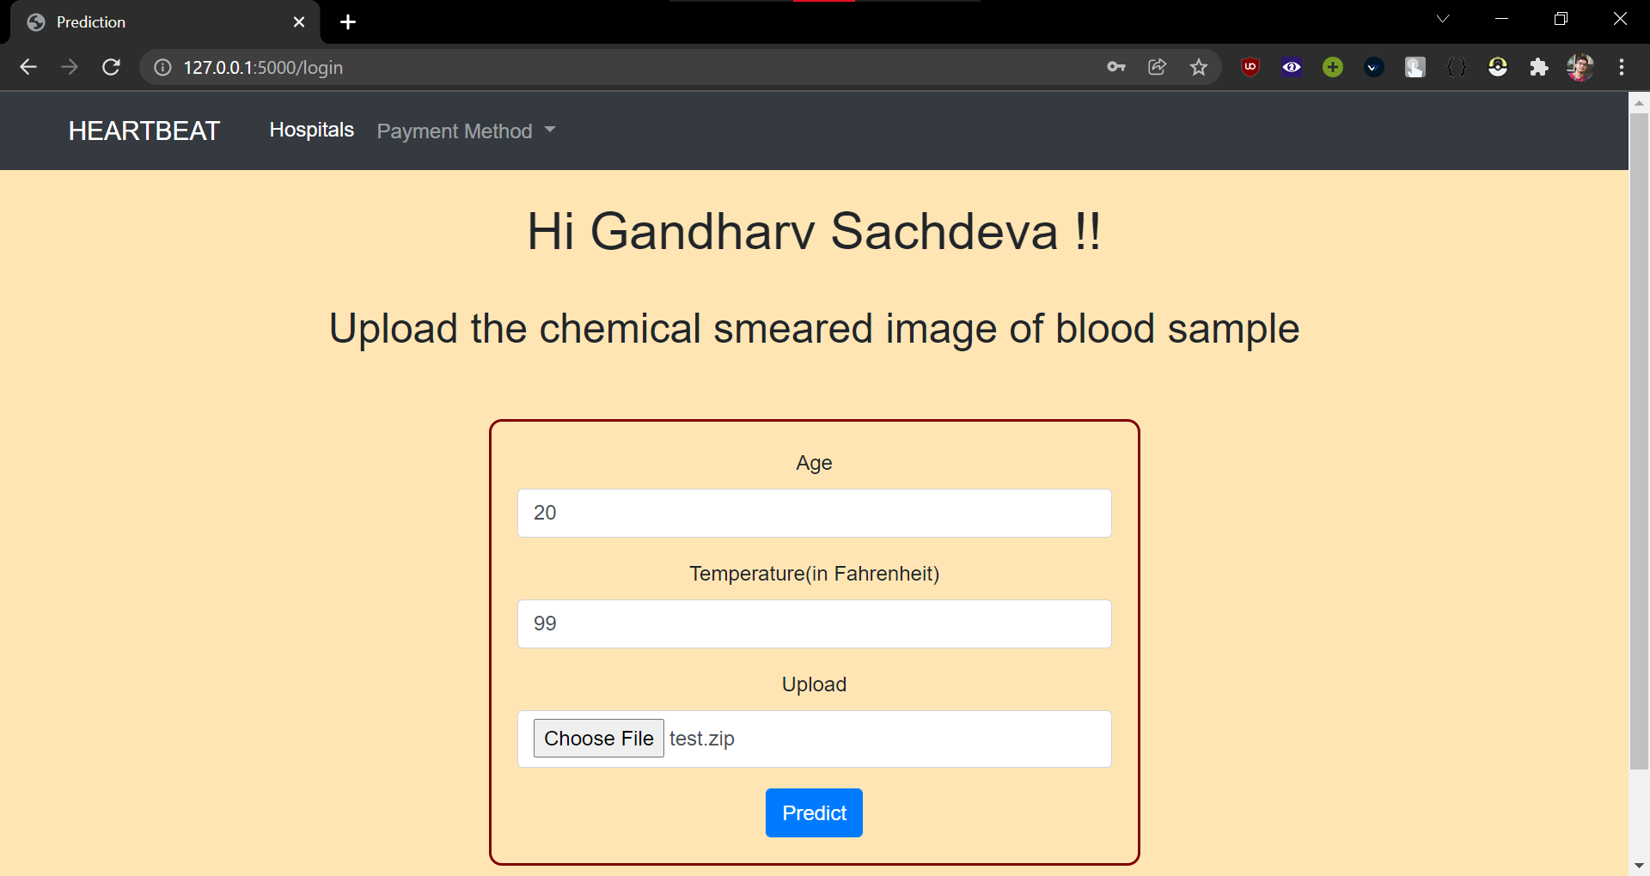
PREDICTION

Slide 36
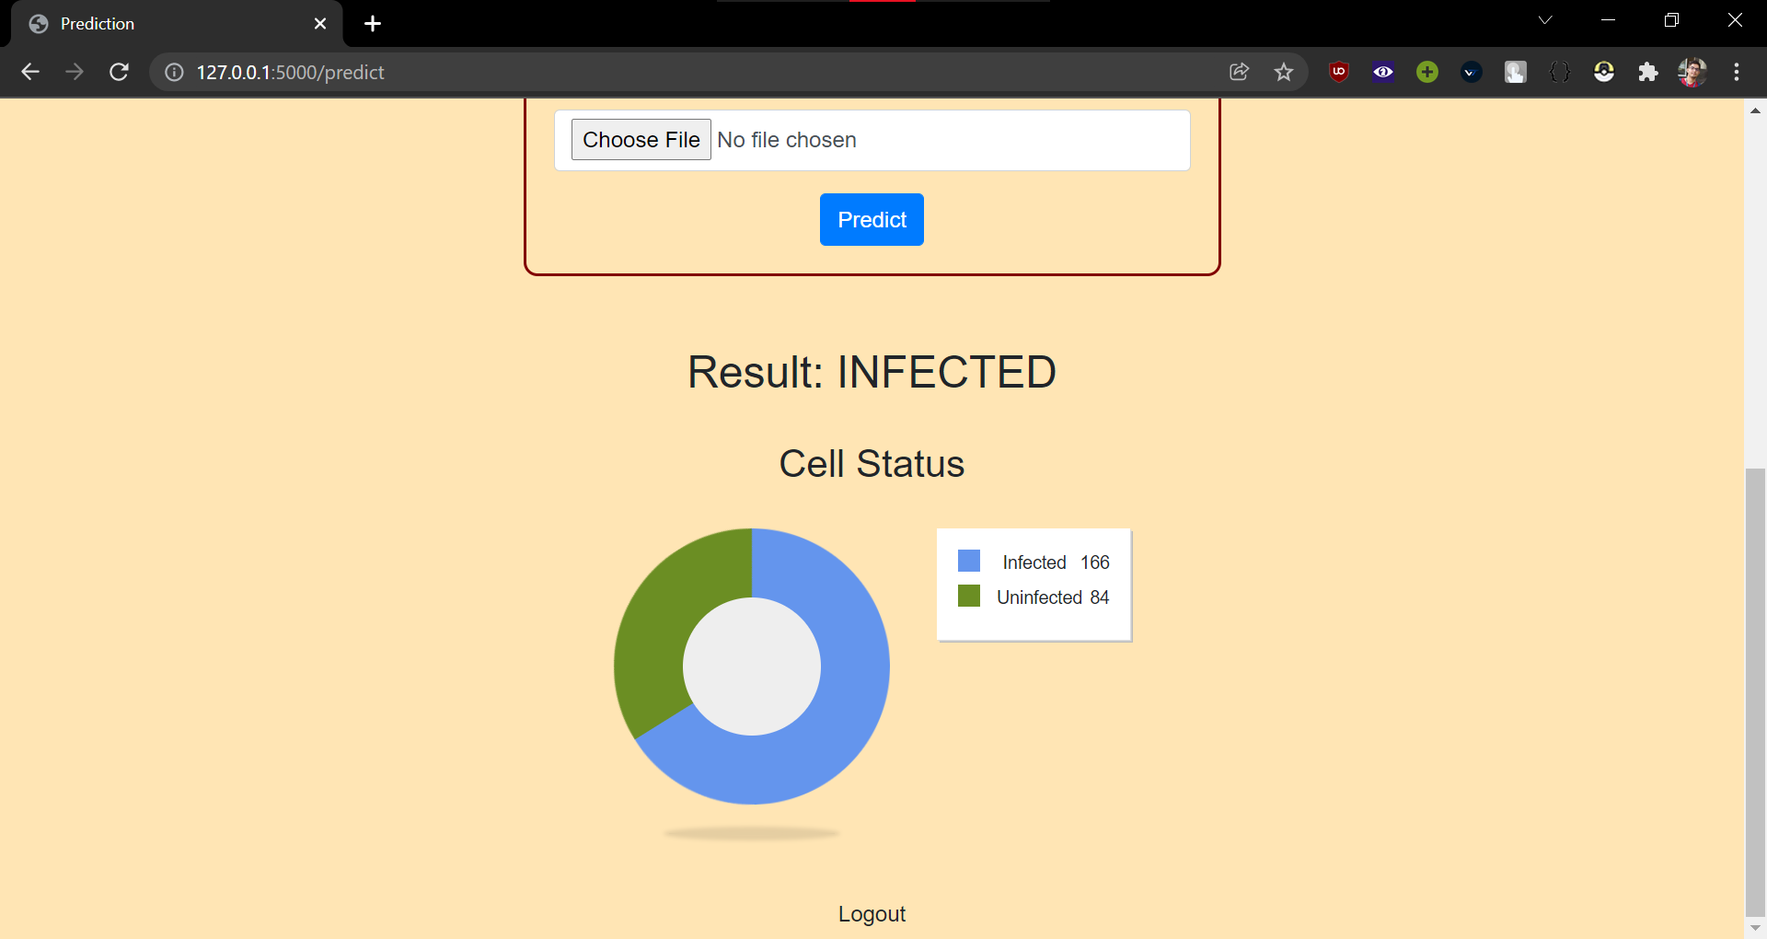
DIAGNOSIS

Slide 37
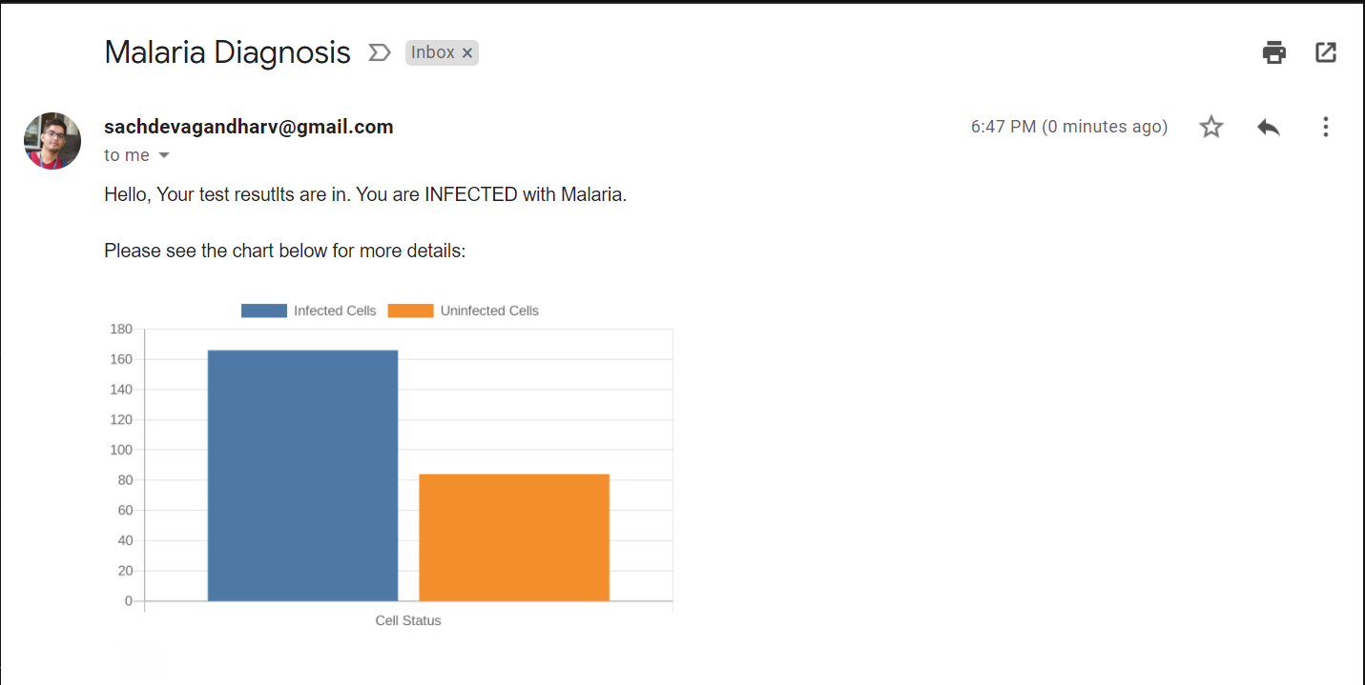
EMAIL

